Slide 1

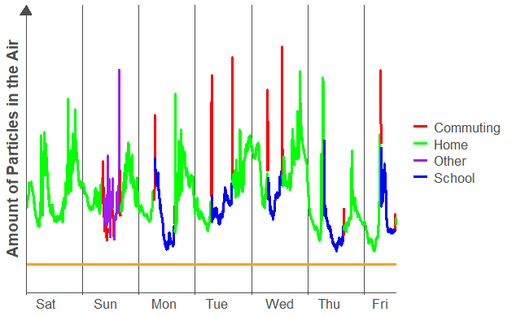
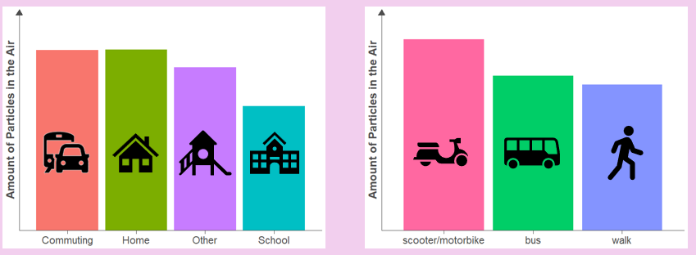
Factors Affecting Childhood Exposures to Urban Particulates (FACE-UP)
Assessment of children’s exposure to particulate air pollution - Summary Findings
This leaflet presents the main findings of a study conducted with children in Kathmandu, Nepal during March – June 2023. We thank all those who contributed to the study activities.
What did we learn from the study?
Children in Kathmandu are exposed to high levels of particles in the air – substantially above internationally-recognised guidelines.
The chart shows one child’s weekly routine. Each day, the air contained different amounts of particles. At all times, the amount of particles in the air was above the international guidelines (the orange line). Most children had a similar pattern.
Children were exposed to highest air pollution when travelling and at home. Levels were lower when children were at school.
Levels were highest when children travelled using scooter / motorbike.

Slide 2
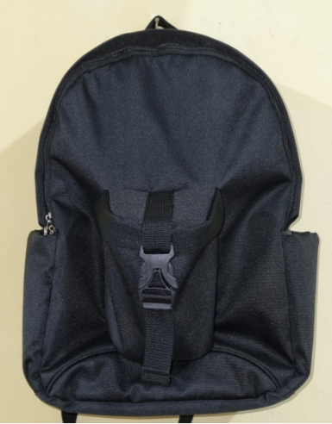
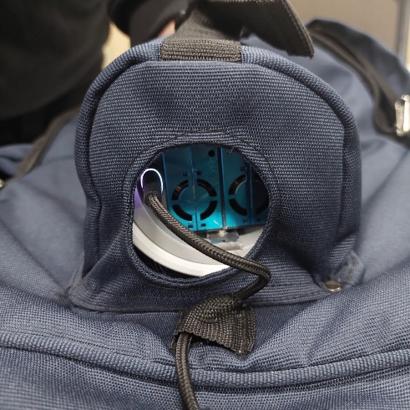
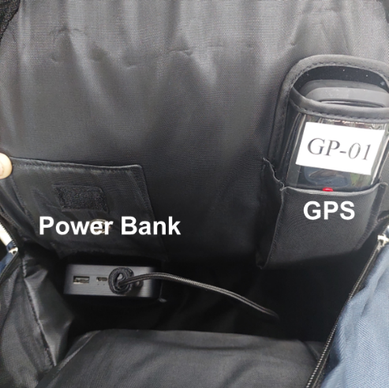



Factors Affecting Childhood Exposures to Urban Particulates (FACE-UP)
Assessment of children’s exposure to particulate air pollution - Summary Findings
What were the aims of the study?
To understand how, when, and where children in Kathmandu are exposed to air pollution as they go about their normal activities.
What did we do?
30 children, aged 6-13 years old, were asked to carry backpacks (photo a) specially designed for holding an air pollution monitor (photo b), along with a power pack and GPS device (photo c) to record the child's location.
The children carried this backpack for a week, and it was taken to school and other locations they visited, as well as being kept in the home.
Questionnaires were used to collect information about the child’s home and school location, as well as their activities and how they travelled to and from school.
a
b
c
What will the results be used for?
Along with information from other FACE-UP studies, we will provide advice on how you can help protect your children from air pollution. We will work with local agencies to help them prioritise protection of children from air pollution.
Where can I get further information on the study?
Further details will be available on our website, https://face-up-consortium.webspace.durham.ac.uk/. Please also contact your local researcher if you have any specific questions.

Slide 4
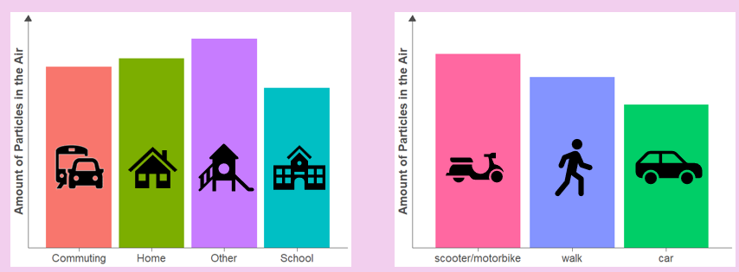
Factors Affecting Childhood Exposures to Urban Particulates (FACE-UP)
Assessment of children’s exposure to particulate air pollution - Summary Findings
This leaflet presents the main findings of a study conducted with children in Bandung, Indonesia, during May and June 2023. We thank all those who contributed to the study activities.
What did we learn from the study?
Children in Bandung are exposed to high levels of particles in the air – substantially above internationally-recognised guidelines.
The chart shows one child’s weekly routine. Each day, the air contained different amounts of particles. At all times, the amount of particles in the air was above the international guidelines (the orange line). Most children had a similar pattern.
Children were exposed to high air pollution in different locations. Levels were lower when children were at school.
Levels were highest when children travelled using scooter / motorbike.

Slide 5
Factors Affecting Childhood Exposures to Urban Particulates (FACE-UP)
Assessment of children’s exposure to particulate air pollution - Summary Findings
What were the aims of the study?
To understand how, when, and where children in Bandung are exposed to air pollution as they go about their normal activities.
What did we do?
30 children, aged 6-13 years old, were asked to carry backpacks (photo a) specially designed for holding an air pollution monitor (photo b), along with a power pack and GPS device (photo c) to record the child's location.
The children carried this backpack for a week, and it was taken to school and other locations they visited, as well as being kept in the home.
Questionnaires were used to collect information about the child’s home and school location, as well as their activities and how they travelled to and from school.
a
b
c
What will the results be used for?
Along with information from other FACE-UP studies, we will provide advice on how you can help protect your children from air pollution. We will work with local agencies to help them prioritise protection of children from air pollution.
Where can I get further information on the study?
Further details will be available on our website, https://face-up-consortium.webspace.durham.ac.uk/. Please also contact your local researcher if you have any specific questions.

