Slide 1

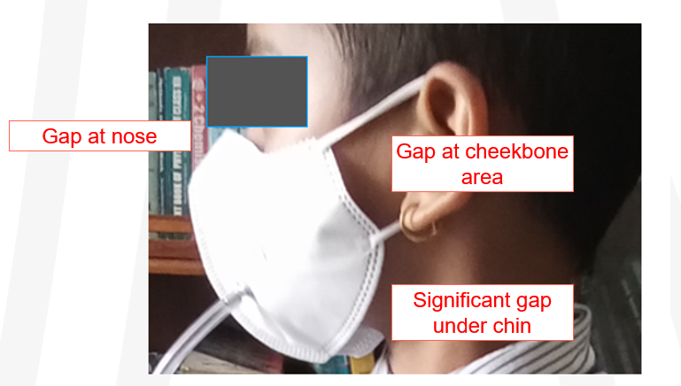
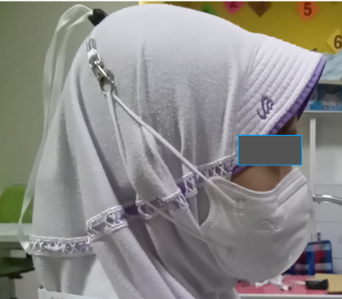
Factors Affecting Childhood Exposure to Urban Particulates (FACE-UP)
Testing facemasks - Summary findings
This leaflet presents the main findings of a study conducted with children in Kathmandu, Nepal during August – October 2023. We thank all those who contributed to the study activities.
What did we learn from the study?
Three children’s KN95 masks (which are excellent at filtering particles), were tested to see how well they fitted the faces of children.
The Double A Care, a horizontal fold mask, fitted the best. Overall, the fit of all masks on children's faces was poor and a good fit was not possible.
Example ear loop clip
However, the masks still stopped 50-75% of particles from being breathed in, which was improved by wearing an additional ear loop clip.
The children did not feel embarrassed when wearing any of the masks tested. The children also thought the masks were comfortable and were easy to breathe through. Some children reported that their faces felt hot when wearing the Jinjiang and Double A Care masks.
The children preferred masks with clips, coloured masks (rather than white ones), and vertical-fold masks (rather than horizontal-fold masks).
What is the take home message?
Although KN95 masks are good at filtering particles, if they do not fill well, they will not be very effective.
Fit can be improved by using an additional ear loop clip. It is important that carers and children know how to fit a mask correctly.

Slide 2
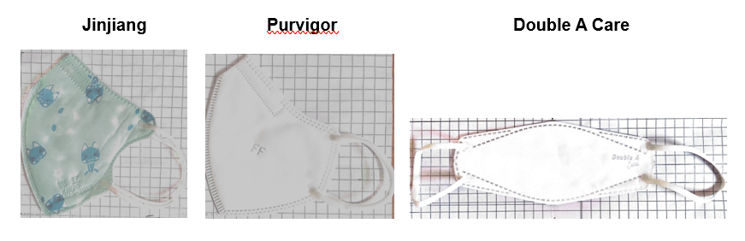
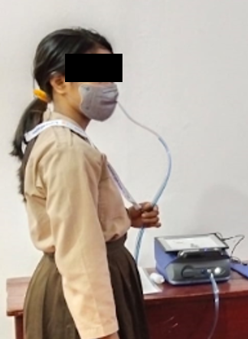



Testing facemasks - Summary findings
What were the aims of the study?
To understand how well masks, designed to ensure a high level of protection against air pollution particles, fit the faces of children. The wearability of the masks and the style the children liked was also assessed.
What did we do?
30 children, aged 6-13 years old, participated in the study. They were asked to test the fit of three children’s masks available in Nepal, previously found to be excellent at filtering small airborne particles.
Each child tested each mask, once without an additional ear loop clip and once with one. During testing, the mask was attached to a monitor that measured small particles in the air inside and outside the mask. The children were asked to complete a set of standard actions (e.g., moving their head, talking) when wearing the masks.
The children's face size was measured. Children were also asked how well they thought the mask fitted their face, how comfortable the mask was when worn and whether they liked the mask, and the reasons why.
What will the results be used for?
Along with information from other FACE-UP studies, we will provide advice on how you can help protect your children from air pollution. We will work with local agencies to help them prioritise protection of children from air pollution.
Where can I get further information on the study?
Further details will be available on our website, https://face-up-consortium.webspace.durham.ac.uk/. Please also contact your local researcher if you have any specific questions.

Slide 4
Factors Affecting Childhood Exposure to Urban Particulates (FACE-UP)
Testing facemasks - Summary findings
This leaflet presents the main findings of a study conducted with children in Bandung, Indonesia, during July – September 2023. We thank all those who contributed to the study activities.
What did we learn from the study?
Three children’s KN95 masks (which are excellent at filtering particles), were tested to see how well they fitted the faces of children.
The Oncare, a horizontal fold mask, fitted the best. Overall, the fit of all masks on children's faces was poor and a good fit was not possible.
Example ear loop clip
However, the masks still stopped 50-75% of particles from being breathed in, which was improved by wearing an additional ear loop clip.
The children did not feel embarrassed when wearing any of the masks tested. The children also thought the masks tested were comfortable, didn’t make them hot and were easy to breathe through.
The children preferred masks with clips, coloured masks (rather than white ones), and vertical-fold masks (rather than horizontal-fold masks).
What is the take home message?
Although KN95 masks are good at filtering particles, if they do not fill well, they will not be very effective.
Fit can be improved by using an additional ear loop clip. It is important that carers and children know how to fit a mask correctly.

Slide 5
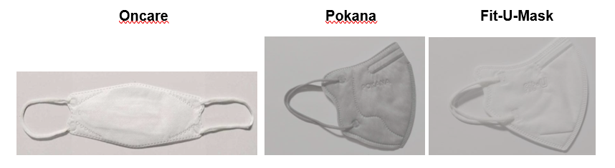
Testing facemasks - Summary findings
What were the aims of the study?
To understand how well masks, designed to ensure a high level of protection against air pollution particles, fit the faces of children. The wearability of the masks and the style the children liked was also assessed.
What did we do?
30 children, aged 6-13 years old, participated in the study. They were asked to test the fit of three children’s masks available in Indonesia, previously found to be excellent at filtering small airborne particles.
Each child tested each mask, once without an additional ear loop clip and once with one. During testing, the mask was attached to a monitor that measured small particles in the air inside and outside the mask. The children were asked to complete a set of standard actions (e.g., moving their head, talking) when wearing the masks.
The children's face size was measured. Children were also asked how well they thought the mask fitted their face, how comfortable the mask was when worn and whether they liked the mask, and the reasons why.
What will the results be used for?
Along with information from other FACE-UP studies, we will provide advice on how you can help protect your children from air pollution. We will work with local agencies to help them prioritise protection of children from air pollution.
Where can I get further information on the study?
Further details will be available on our website, https://face-up-consortium.webspace.durham.ac.uk/. Please also contact your local researcher if you have any specific questions.

